Slide 1
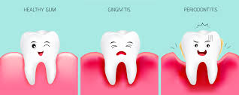
GINGIVAL INFLAMMATION
Dr Sonika Bodhi
Reader
Dept of periodontics

Slide 2
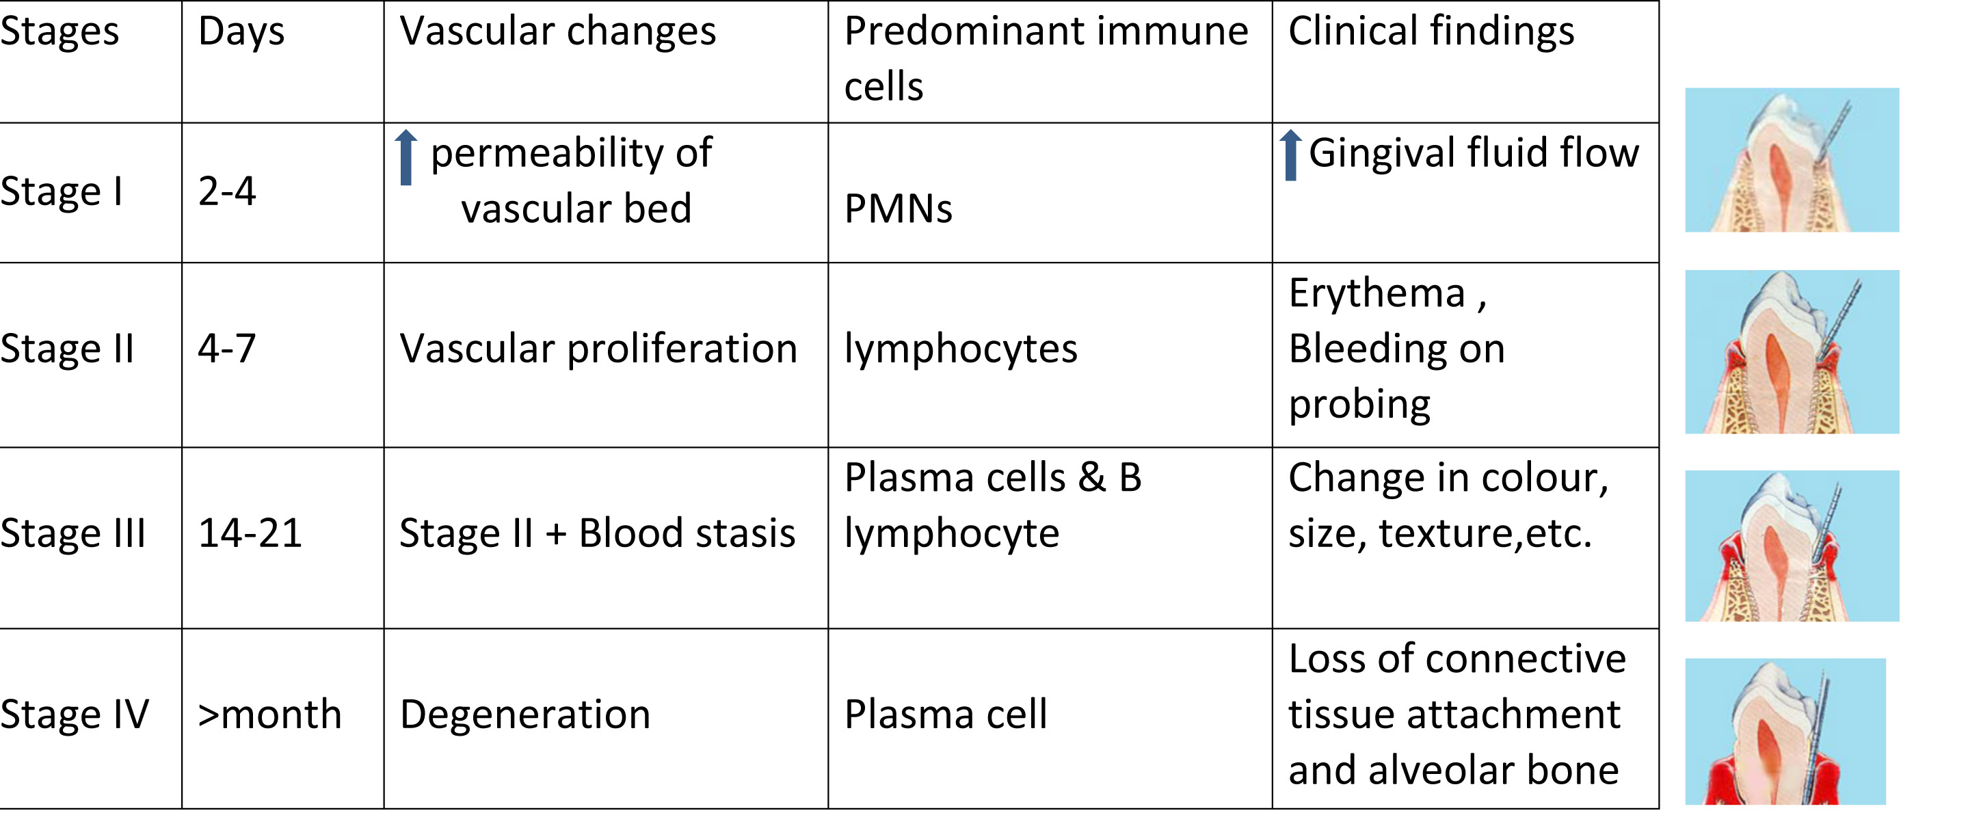

Slide 3
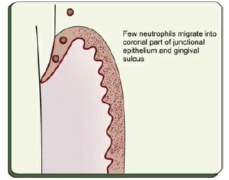
PRISTINE GINGIVA

Slide 4
STAGE I GINGIVITIS: THE INITIAL LESION
vascular changes
dilated capillaries and increased blood flow.
occur in response to microbial activation of resident leukocytes and the subsequent stimulation of endothelialcells.
Clinically, this initial response of the gingiva to bacterial plaque (subclinical gingivitis) is not apparent

Slide 5
Microscopically
Signs of acute inflammation seen in the connective tissue beneath the junctional epithelium.
Changes in blood vessel morphologic features (e.g., widening of small capillaries or venules)
Adherence of neutrophils to vessel walls (margination) occur within 1 week and sometimes as early as 2 days after plaque accumulation.
Leukocytes, mainly PMNs, leave the capillaries by migrating through the walls (diapedesis, emigration)

Slide 6
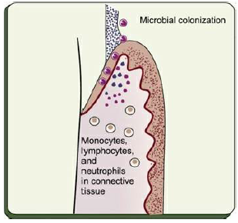

Slide 7
STAGE II GINGIVITIS: THE EARLY LESION
The early lesion evolves from the initial lesion within about 1 week after the beginning of plaque accumulation.
Clinically, no clear-cut dividing line.
As time goes on, clinical signs of erythema may appear,
  proliferation of capillaries and
  increased formation of capillary loops between rete pegs or ridges

Slide 8
Bleeding on probing
Between 6 and 12 days .... Increased Gingival fluid flow and transmigrating leukocytes

Slide 9
Microscopically
Gingiva reveals leukocyte infiltration in the connective tissue beneath the junctional epithelium,
consisting mainly of lymphocytes (75%, with the majority T cells), but also composed of some migrating neutrophils, as well as macrophages, plasma cells, and mast cells.

Slide 10
All the changes seen in the initial lesion continue to intensify with the early lesion.
The junctional epithelium:
  densely infiltrated with neutrophils,
  development of rete pegs or ridges.

Slide 11
70% collagen is destroyed around the cellular infiltrate.
The main fiber groups affected
  circular and dentogingival fiber assemblies

Slide 12
Polymorphonuclear leukocytes (PMNs)
leaves the blood vessels
cross the basement lamina,
found in the epithelium, emerging in the pocket area.
PMNs engulf bacteria in the process of phagocytosis.
Fibroblasts show cytotoxic alterations, with a decreased capacity for collagen production

Slide 13
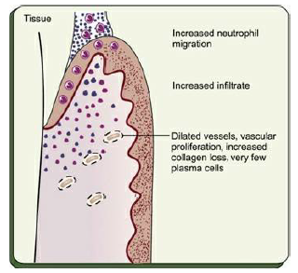

Slide 14
STAGE III GINGIVITIS: THE ESTABLISHED LESION
predominance of plasma cells and B lymphocytes (IgG1 and IgG3) subclasses and probably in conjunction with the creation of a small gingival pocket lined with a pocket epithelium.

Slide 15
In chronic gingivitis, which occurs 2 to 3 weeks after the beginning of plaque accumulation,
the blood vessels become engorged and congested, venous return is impaired, and the blood flow becomes sluggish.
The result is localized gingival anoxemia, which superimposes a somewhat bluish hue on the reddened gingiva

Slide 16
Extravasation of erythrocytes into the connective tissue and breakdown of hemoglobin into its component pigments can also deepen the color of the chronically inflamed gingiva.
described as moderately to severely inflamed gingiva

Slide 17
Histologically
increased number of plasma cells- preponderant inflammatory cell type.
Plasma cells invade deeply into the connective tissue, around blood vessels, and between bundles of collagen fibers

Slide 18
The junctional epithelium reveals widened intercellular spaces filled with granular cellular debris, including lysosomes derived from disrupted neutrophils, lymphocytes, and monocytes.
The lysosomes contain acid hydrolases that can destroy tissue components.

Slide 19
The junctional epithelium develops rete pegs or ridges that protrude into the connective tissue, and the basal lamina is destroyed in some areas.
In the connective tissue, collagen fibers are destroyed around the infiltrate of intact and disrupted plasma cells, neutrophils, lymphocytes, monocytes, and mast cells

Slide 20
An inverse relationship appears to exist between the number of intact collagen bundles and the number of inflammatory cells.
Collagenolytic activity is increased in inflamed gingival tissue by the enzyme collagenase.
Collagenase is normally present in gingival tissues and is produced by some oral bacteria and by PMNs

Slide 21
Enzyme histochemistry studies have shown that chronically inflamed gingivae have elevated levels of acid and alkaline phosphatase, β-glucuronidase, β-glucosidase, β-galactosidase, esterases, aminopeptidase and cytochrome oxidase.
Neutral mucopolysaccharide levels are decreased, presumably as a result of degradation of the ground substance

Slide 22
Established lesions of two types and appear to be reversible;
  some remain stable and do not progress for months or years, and
  others seem to become more active and to convert to progressively destructive lesions.

Slide 23
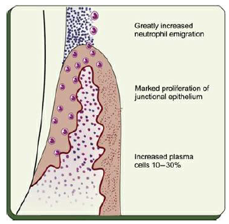

Slide 24
STAGE IV GINGIVITIS: THE ADVANCED LESION
Extension of the lesion into alveolar bone characterizes a fourth stage known as the advanced lesion or phase of periodontal breakdown

Slide 25
Microscopically
there is fibrosis of the gingiva
widespread manifestations of inflammatory and immunopathologic tissue damage.
plasma cells continue to dominate the connective tissues, and neutrophils continue to dominate the junctional epithelium and gingival crevice

